Slide 1
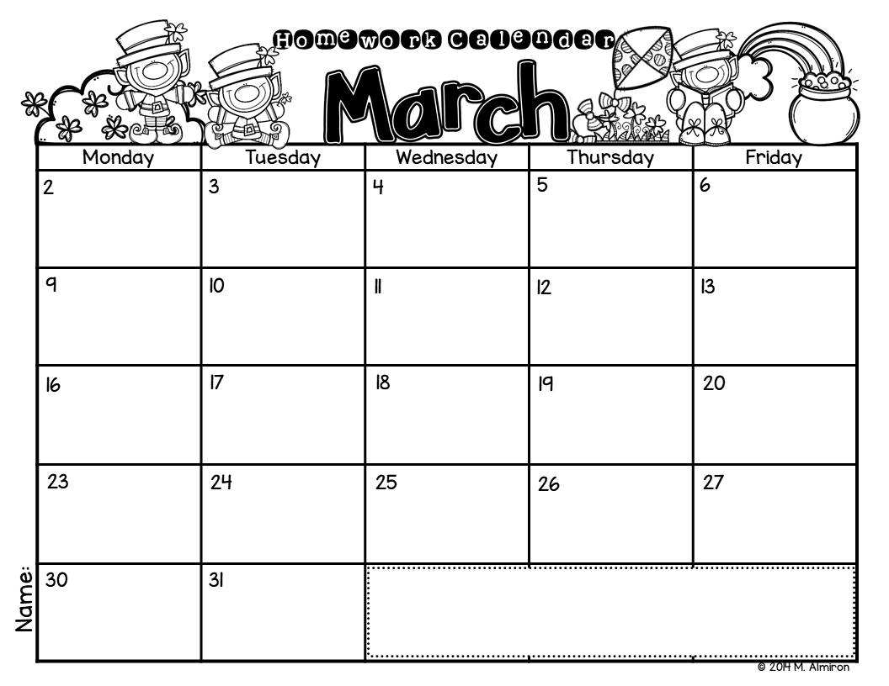
Draw and write about your favorite Dr. Seuss character.
Line up 10 objects. Practice ordinal numbers.
Write an addition sentence
(i.e.: 2 + 2 = 4). Draw objects to represent.
Draw a rainbow. Write about it.
Retell as story we read in school. Write about your favorite part.
Line up 10 objects. Practice ordinal numbers.
Write 3 question sentences.
Retell as story we read in school. Write about your favorite part.
Write 3 sentences using sight words.
Circle all the sight words you can find in a newspaper or magazine.
What would you do if you catch a leprechaun? Write and illustrate.
What would you do if you find a pot of gold? Write about it, and illustrate.
Write about a time you thought you were very lucky. Illustrate.
Write a list of things that shine like gold.
Write a list of words you can make with the letters in: “Leprechaun”.
Write a list of words from the “_old” family.
Draw a kite. Write about it.
Write a list of things you see in the Spring.
Write about your favorite thing to do in Spring.
Circle all the sight words you can find in a newspaper or magazine.
Write an addition sentence
(i.e.: 2 + 2 = 4). Draw objects to represent.
Write the steps to plant a seed.
Please color the boxes as you complete each activity.
Don’t forget to read for 20 minutes every night!

